Slide 1

UNIVERSITY INSTITUTE OF ENGINEERING
DEPARTMENT OF COMPUTER SCIENCE & ENGINEERING
Master of Engineering (Computer Science & Engineering)
Subject Name : Soft Computing
Department: CSE
Prepared By: Er. Komal Sharma.
DISCOVER . LEARN . EMPOWER

Slide 2
COURSE DESCRIPTION
Soft Comtuting is everywhere.
An umbrella term used to describe types of algorithms that produce approximate solutions to unsolvable high-level problems in computer science.

Slide 3
COURSE OBJECTIVES
To understand soft computing concepts and techniques
To foster their abilities in designing and implementing soft computing based solutions for real-world and engineering problems.
To Introduce students to fuzzy systems, fuzzy logic and its applications.
To Provide the mathematical background for carrying out the optimization associated with neural network learning.

Slide 4
COURSE OUTCOMES
On completion of this course, the students are expected to have learnt about the following:
C01 | Describe familiarity with the basic concepts related to soft computing
CO2 | Illustrate various fuzzy lgic functions
CO3 | Analyze numerous artificial neural network types
CO4 | Outline fundamental concepts of genetic algorithms in machine learning
CO5 | Develop hybrid nature of FIS techniques to real world problems by extending the capabilities of existing technology

Slide 5
Chapter 1.1.2
Hard vs. Soft Computing

Slide 6
Chapter 1.1.2
Soft Computing:
Soft computing represents the certitude that the human mind has the capability to store and process information that is imprecise and lacks certainty. • In the current scenario, soft computing has developed in various domains as it solves the problem associated with current technology.
• For example: – Applied Mathematics – Multimedia Processing – Business and Economics – Medical engineering, etc. and various other areas.

Slide 7
Chapter 1.1.2
Hard Computing
Hard computing has conventional intelligence and requires an analytical model. Hard computing generally requires prewritten programs and thus acts on a fixed set of instructions.
• Hard computing needs predefined instructions and does not work beyond those lines. Its principle relies on certainty and flexibility.
• Soft computing is a new and modern approach that approximates systems

Slide 8
Chapter 1.1.2
Hard vs. Soft Computing
Hard computing is best for solving the mathematical problems which don’t solve the problems of the real world.
Soft computing is better used in solving real world problems as it is stochastic in nature i.e., it is a randomly defined process that can be analyzed statistically but not with precision.

Slide 9
Chapter 1.1.2
Hard vs. Soft Computing(Cont…..)
Hard computing relies on binary logic and predefined instructions like a numerical analysis and brisk software and uses two-valued logic.
Soft computing is based on the model of the human mind where it has probabilistic reasoning, fuzzy logic, and uses multivalued logic.
Hard computing needs exact input of the data and is sequential; on the other hand, Soft computing can handle an abundance of data and handles multiple computations which might not be exact in a parallel way.

Slide 10
Chapter 1.1.2
Hard vs. Soft Computing(Cont…..)
Hard computing takes a lot of time to complete tasks and is costly while soft computing tolerance of uncertainty and imprecision is estimated to achieve Machine Intelligence Quotient (MIQ) and lower cost.
It also provides better communication.
Hard computing is best suited for solving mathematical problems which give some precise answers.
Soft computing resolves the nonlinear issues that involve uncertainty and impreciseness as it has human-like intelligence that can resolve the real-life issue.

Slide 11
Chapter 1.1.2
Hard vs. Soft Computing(Cont…..)
Hard computing takes a lot of time in computing as it requires the stated analytical model and the model soft computing is based on is that of human intelligence.

Slide 12
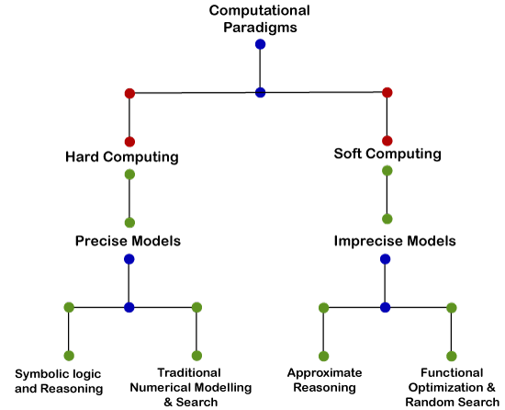
Chapter 1.1.2
Hard vs. Soft Computing(Cont…..)

Slide 13
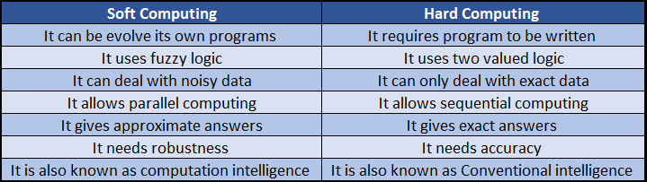
Chapter 1.1.2
Hard vs. Soft Computing(Cont…..)

